Slide 1
Mini Lightsaber
Zach Bayler

Slide 2
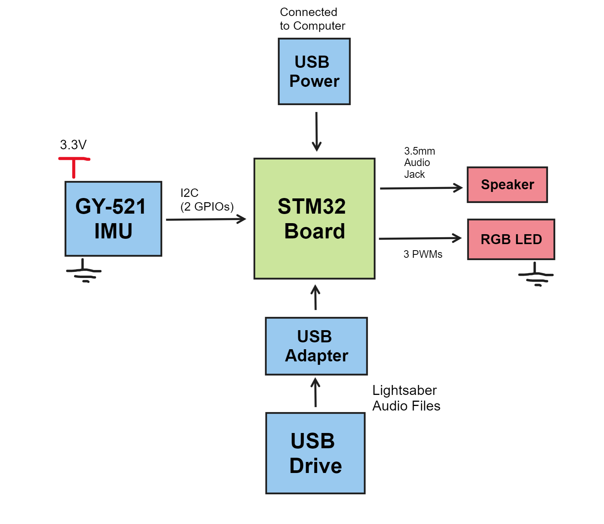
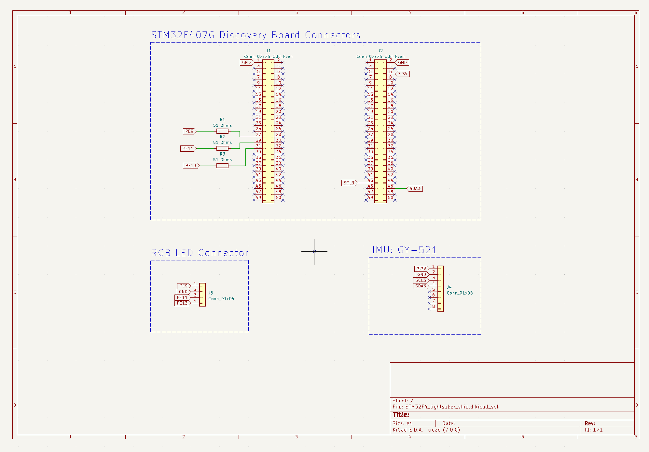
Circuit Design

Slide 3
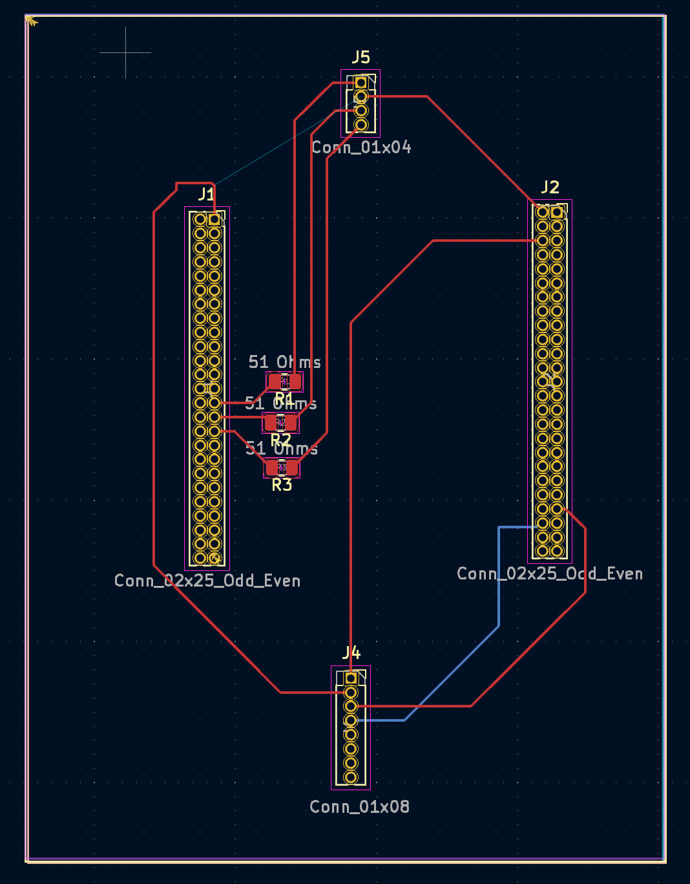
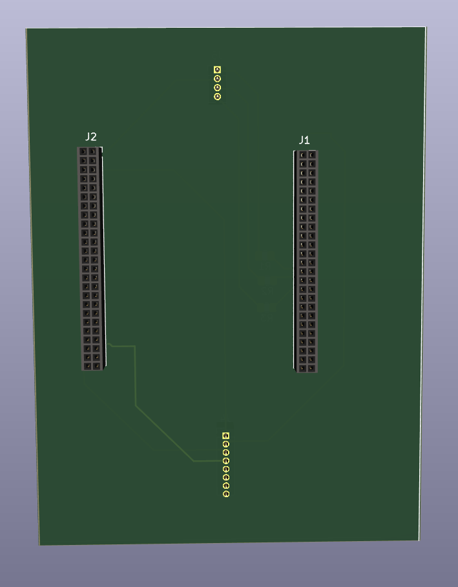
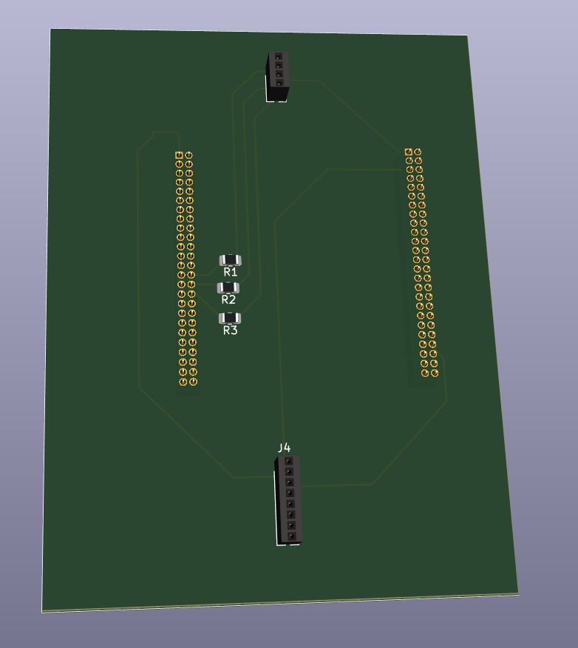
PCB Shield Design

Slide 4
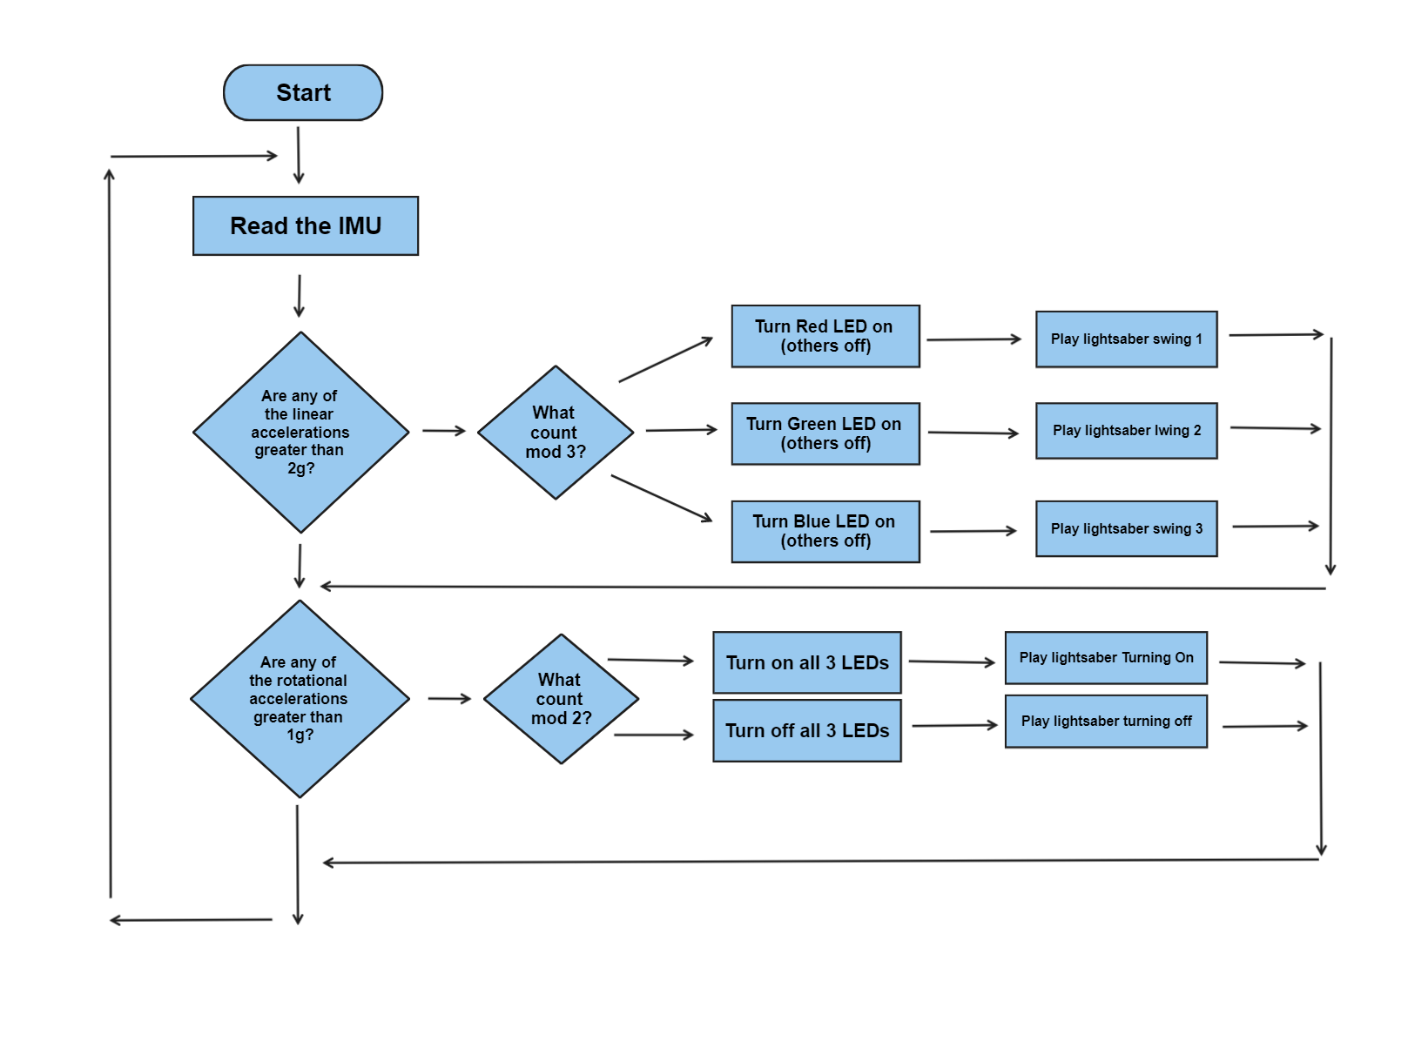
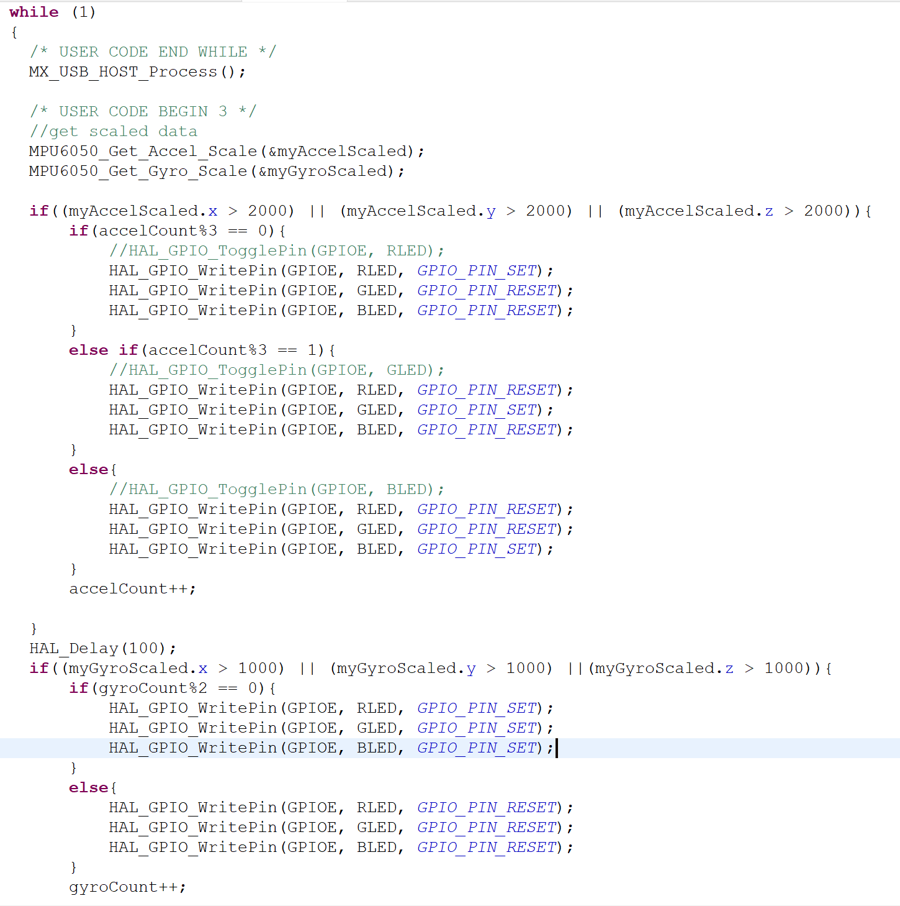
Code Design

Slide 5
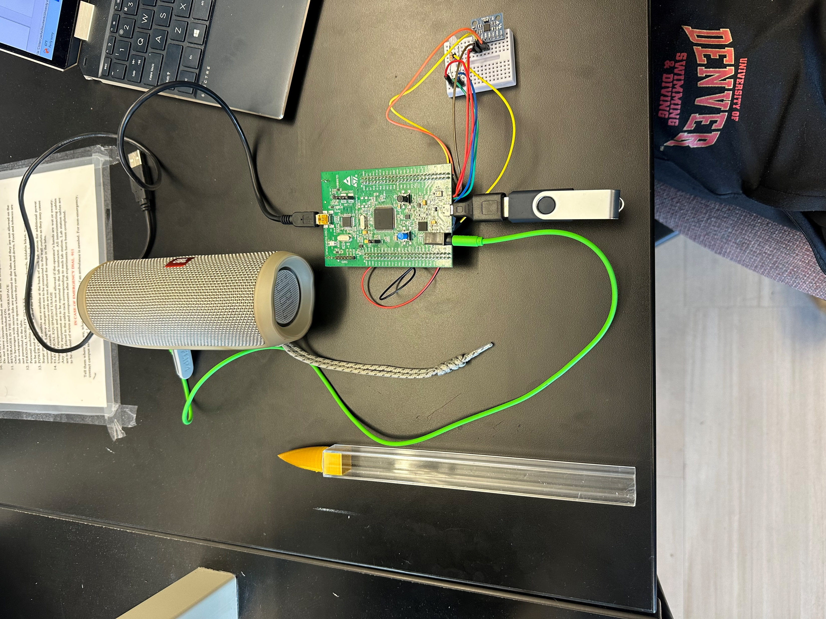
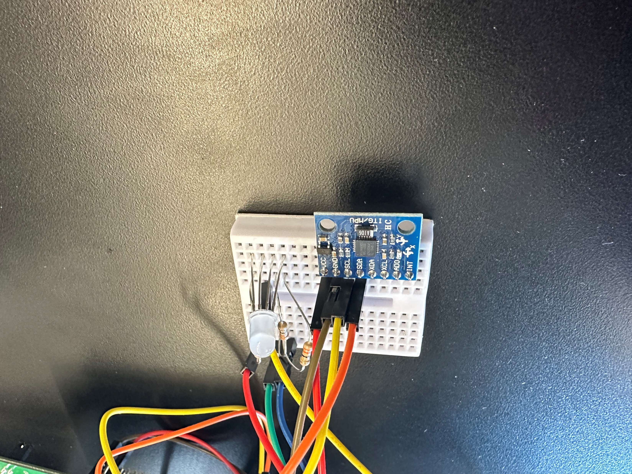
Physical Design
Speaker
STM32F4 Board
RGB LED
USB Drive and Adapter
GY-521
Lightsaber blade

Slide 6
Status
Next Steps
Completed:
Bought the adapter
Built the blade
Tested IMU
Calibrated data
Tested LEDs
On/off and multiple colors
Struggles:
Can’t get the audio to work
Adding more sounds
Add different activation conditions
Add brightness functinoality

